Slide 1
Introduction to Molecular Phylogenetic Analyses
GDW 2018
Colorado State University
Slatteryjp@si.edu
Jill.Pecon.Slattery@gmail.com www.cornerstonegenomics.com

Slide 2
What Is Phylogenetic Analysis?
Phylogeny = Evolutionary history
Reconstruction of evolutionary history using shared traits among organisms
Tree of life (http://www.tolweb.org/tree/)
Phylogenetic reconstruction
Evolutionary model
Data
Morphological: phenotypic variation within traits, how to code, not all traits shared
Molecular Genetic: discrete, common to all life
Homologous: descended from a common ancestor
Resultant Tree
Topology
Structure of interconnecting nodes and branches (bifurcating)
Internal nodes represent hypothetical common ancestors
Branch lengths
Estimates of divergence
Estimation of elapsed time between nodes of tree
Time since taxa last shared a common ancestor
Molecular Clock Hypothesis
Zuckerkandel and Pauling (1965):Molecules as Documents of Evolutionary History

Slide 3
Phylogenetic Tree
Phylogram
Tree branch length proportional to genetic divergence
Cladogram
Topology only, branching order important
Character data
Rooted
Outgroup
Midpoint rooting
Unrooted
Consensus tree:
Consensus of multiple trees obtained under same optimality criteria
Bootstrap, jackknife results
Tree Programs:
TreeView (website) http://taxonomy.zoology.gla.ac.uk/rod/treeview.html
FigTree (website) http://evolve.zoo.ox.ac.uk/software.html?id=figtree

Slide 4
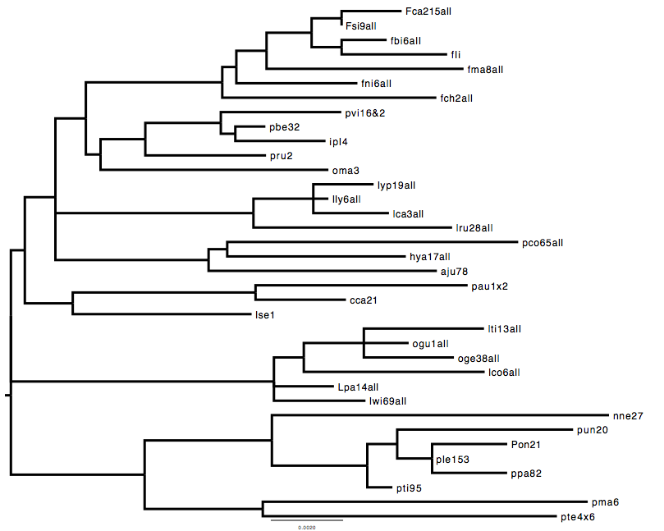
Midpoint Rooted Phylogram

Slide 5
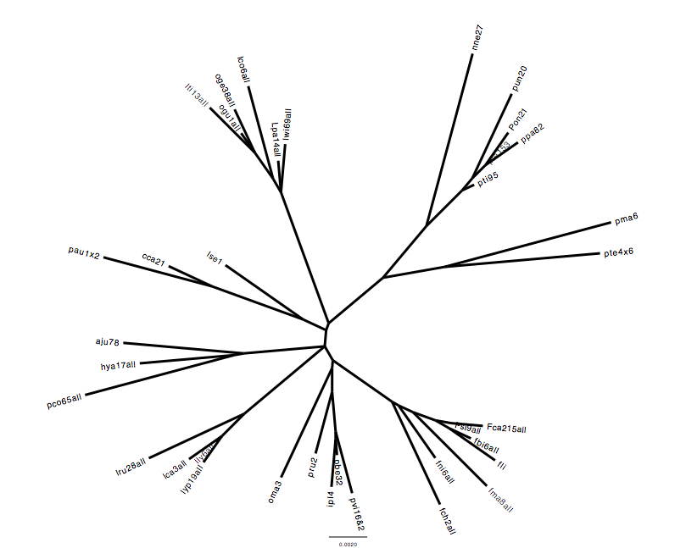
Unrooted Phylogram

Slide 6
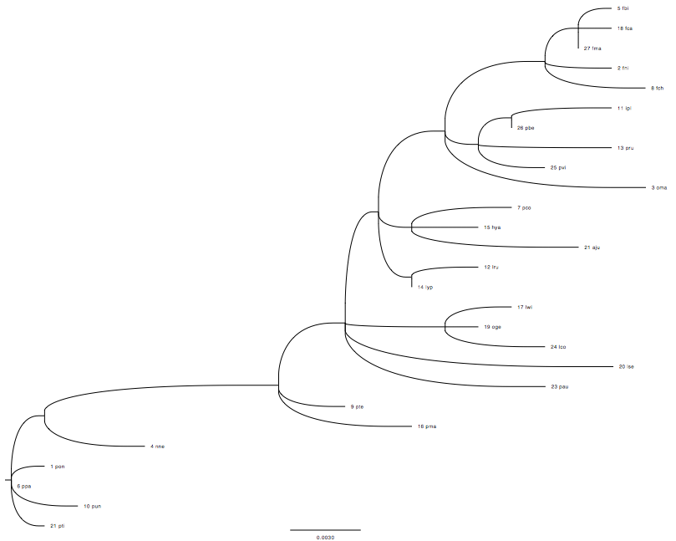
Cladogram

Slide 7
Basic Steps in Phylogenetic Analysis: Part 1
Step 1: Determination of informative marker
Rate of evolution “roughly” proportional to genetic divergence
Multiple markers
MtDNA, nuclear, sex linked
Step 2: Determination of sample size and design
Taxa
Outgroup-root
Step 3: Alignment (sequence data)
Step 4: Model of substitution
Nucleotide data
Among site rate heterogeneity
Bias Frequency Nucleotides
Transition: transversion
Codon analyses
Protein Data
Probability matrix [DAYHOFF, DCMUT, JTT, MTREV, WAG, RTREV, CPREV, VT, BLOSUM62, MTMAM, LG] or empirical frequencies of amino acid within data set.

Slide 8
Basic Steps in Phylogenetic Analysis: Part 2
Step 5. Reconstructing phylogenetic tree
Impose optimality criteria
Maximum Likelihood
Minimum Evolution (distance-based)
Maximum Parsimony
Bayesian Inference (MCMC)
Computer Programs
PAUP, MEGA, GARLI, RAxML, PhyML, MrBayes
Supercomputers ExaML, RAxML-light
whole vertebrate genomes (e.g. Bird phylogeny)
PartitionFinder
best-fit partitioning schemes and models of molecular evolution for phylogenetic methods
Step 6. A posteriori evaluation
Bootstrap
Assessment of tree reliability
Re-sampling with replacement
Node support
Jackknife
Random sampling without replacement
Sites or taxa
Bayesian Posterior Probability of model parameters

Slide 9
Categories of Markers Applied in Phylogenetics
Whole Genome Comparisons
Comparison of syntenic regions (Conserved Sequence Blocks)
Protein Coding Data
Homologs versus Paralogs
Gene duplication and Gene Loss
Amino Acid versus Nucleotide
Synonymous substitutions
Nonsynonymous substitutions (missense mutations)
MtDNA
Pattern of Inheritance Bias
Matrilineal
Single Evolutionary Unit despite different genes evolving at different rates
Autosomes, X & Y Chromosomes
Rates of evolution differ among chromosomes
Y/X > 1 Male-driven evolution linked with spermatogenesis
Retroelements
SINEs, Endogenous retroviruses,
Microsatellites, SNPs, SNVs

Slide 10
Selection of Appropriate Genetic Marker
Informative: “Garbage In, Garbage Out”
Relative time scale of comparison
Mammalian Evolution (130 MY)
Carnivore Evolution (40 MY)
Felidae Evolution (10 MY)
Phylogeography and Population Genetics of Cat Species (0.01-0.5 MY)
Domestic cat (6000 years ago)
Neutral Evolution: Does it exist?
First proposed by Kimura (1968): amino acid changes are selectively neutral driven by mutation rate and genetic drift.
Short answer : unlikely
Genomes and genes under strong selection
Maintain function (purifying selection)
Diversification to adapt or to gain function (positive selection)
Is this really a problem?
Phylogenetics still very useful tool to detect and describe
How many markers?
Robustness: Each additional marker strengthens overall topology
Accuracy: Markers reflect evolutionary and natural history
Precision: Markers evolve similarly throughout phylogeny
Empirical Consensus: Combined Data Optimal but Multi-species coalescence Approaches gaining in popularity

Slide 11
Heuristic Searches
Finding the optimal tree from a multiple sequence file. Tree with the highest score possible under the different optimality criteria (ML, MP, ME, BAYESIAN)
Problem- exhaustive search computationally intensive-not recommended for more than 10 sequences in an alignment
e.g. an alignment of 20 sequences will require testing differences between 2 x 10²⁰ potential trees..
Heuristic searches designed as short cuts through all possible tree space:
Nearest neighbor interchange (NNI)
Subtree-Pruning-regrafting (SBR)
Tree bisection reconnection (TBR)
If suspect local optimum:
Alter the starting tree: rearrange input order, star decomposition, iterative step-wise addition.

Slide 12
Phylogenetic Pitfalls
Recombination
Gene conversion
Gene duplication
Gene loss
Selection
Insufficient elapsed time since last shared common ancestor
Ancestral polymorphisms
Incomplete lineage sorting (discordant gene trees)
Saturation of sites (multiple hits)
Long branch attraction (inadequate taxon sampling)
Inadequate models of amino acid or nucleotide substitution

Slide 13
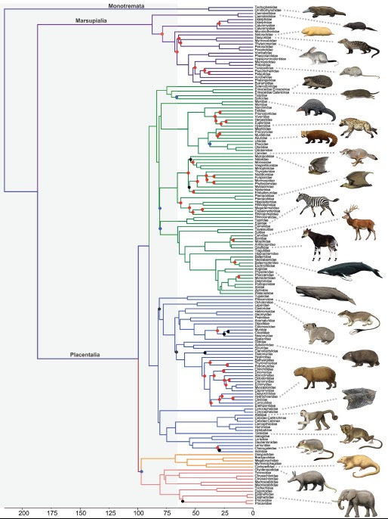
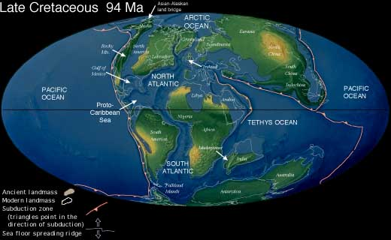
Scale: Mammalian Evolution
Ancester of Eutherian (placental)
Mammals arose ~100 MYA
KTR (Cretaceous Terrestrial Revolution)
80-82 MYA
KPg (Cretaceous Paleogene mass extinction)
65.5 MYA
/ www.sciencexpress.org / 22 September 2011 / Page 1/ 10.1126/science.1211028

Slide 14
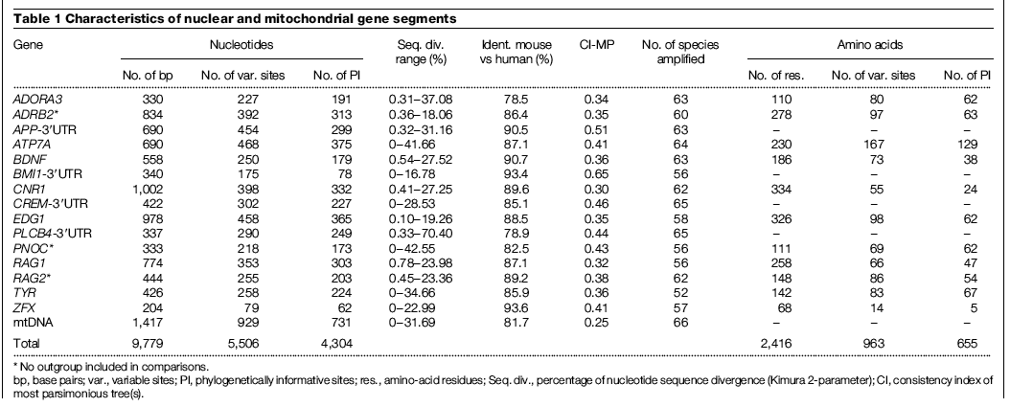
Experimental Design: Mammalian Evolution
/ www.sciencexpress.org / 22 September 2011 / Page 1/ 10.1126/science.1211028

Slide 15
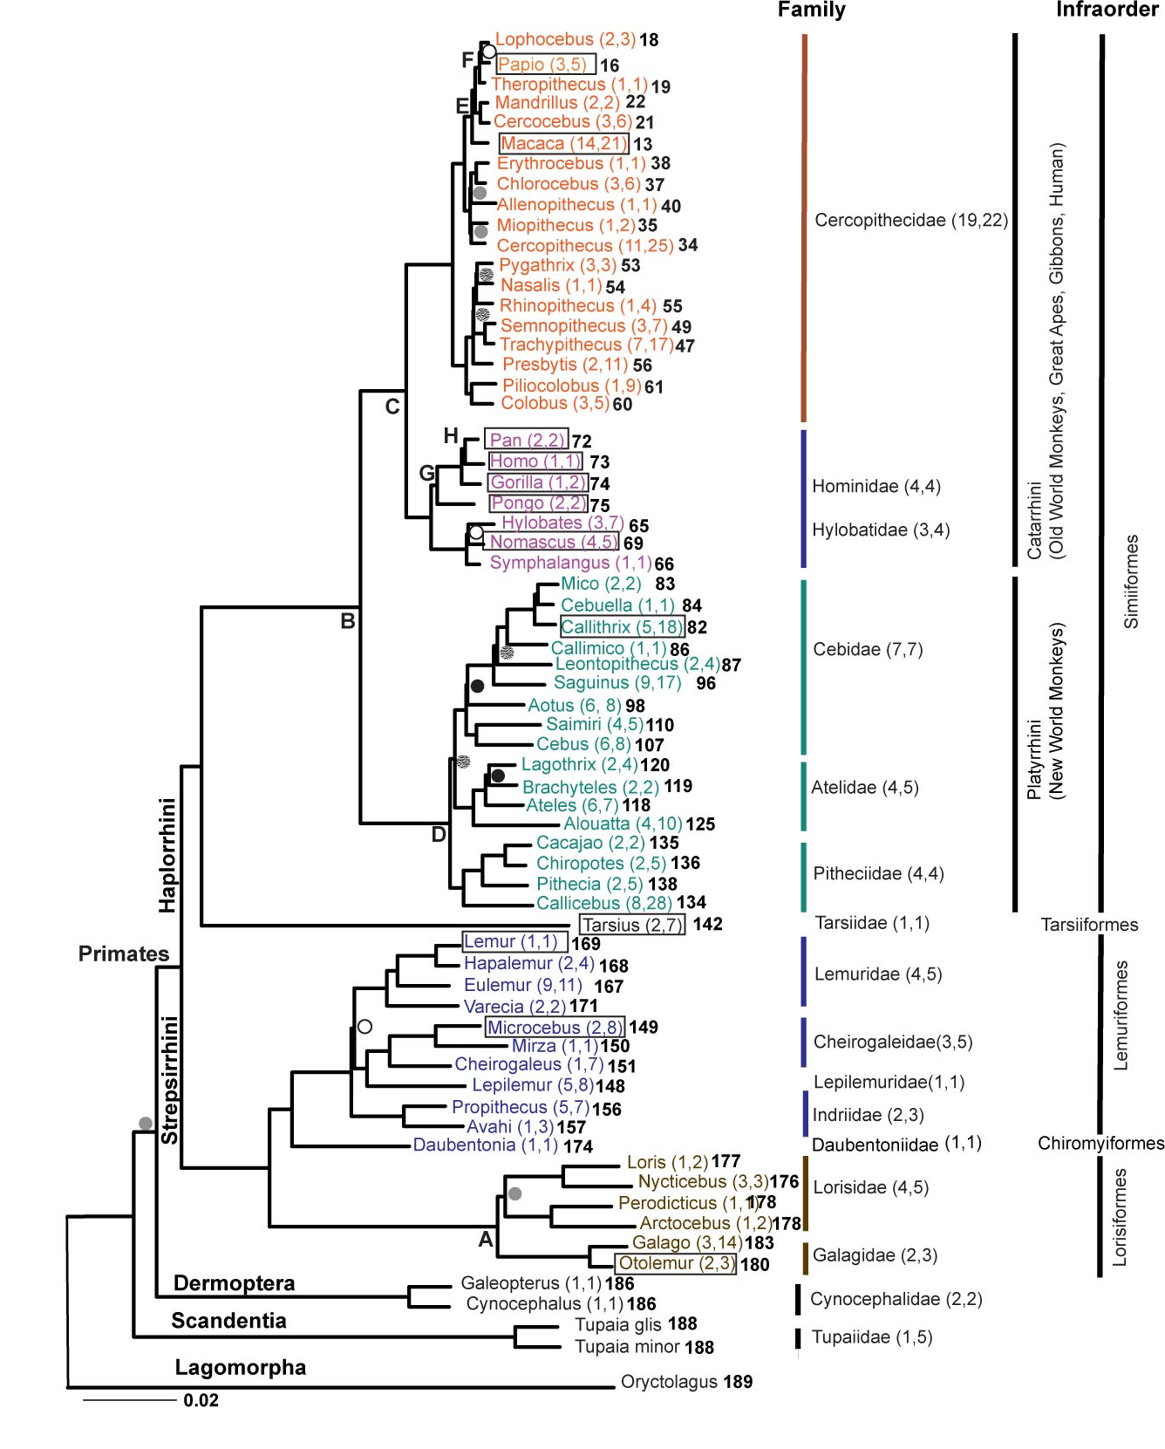
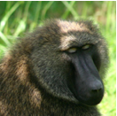
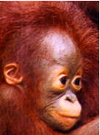
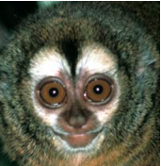
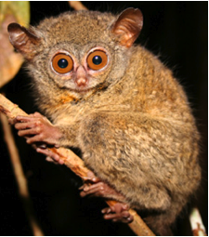
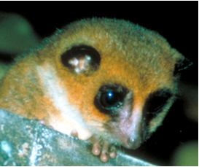
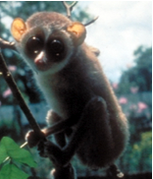
Scale : Primate Evolution
SAMPLING
Representing 90% of diversity present in Primate Order
~90% genera, ~50% species
Boxed species are those either completed or in progress for Whole Genome Sequence
60 Primate Genera, 5 outgroups,
Informative geness of primate evolution
54 genes
Exon, intron, UTR regions
X, Y and Autosomal locations
Large-Scale Sequencing
43,943 sites edited to 34,927 sites
8.4 Mb data reduced to 6.7 Mb of aligned sequence data
PHYLOGENETIC RECONSTRUCTION
Maximum Likelihood (Garli ver 0.96)
Maximum Parsimony (PAUP ver 4d106dev_icc)
DATING NODES (BEAST)
Calibrated by fossil record
A Galigidae-Lorisidae split 38-42 MYA
B Simiiformes 36-50 MYA
C Catarrhini 20-38 MYA
D Platyrrhini 20-27 MYA
E Papionini 6-8 MYA
F Theropithecus 3.5-4.5 MYA
G Hominidae 13-18 MYA
H Homo-Pan split 6-7 MYA

Slide 16
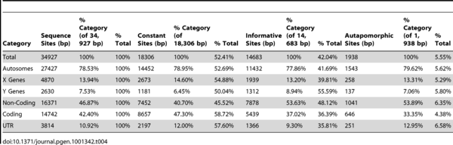

Partitions of Informative Markers
Table 4. Sequence Variation by Gene Category and Data Partition in Primate Phylogeny after Correction For Ambiguous Sites.
Perelman P, Johnson WE, Roos C, Seuánez HN, Horvath JE, et al. (2011) A Molecular Phylogeny of Living Primates. PLOS Genetics 7(3): e1001342. https://doi.org/10.1371/journal.pgen.1001342
http://journals.plos.org/plosgenetics/article?id=10.1371/journal.pgen.1001342

Slide 17
Scale: Species and Subspecies Great Apes
Kuhlwilm, M. et al Evolution and demography of the great apes. Current Opinion in Genetics & Development 2016, 41:124–129

Slide 18
Whole Genome Informative Markers: Great Apes Species and Subspecies
J Prado-Martinez et al. Nature 000, 1-5 (2013) doi:10.1038/nature12228

Slide 19
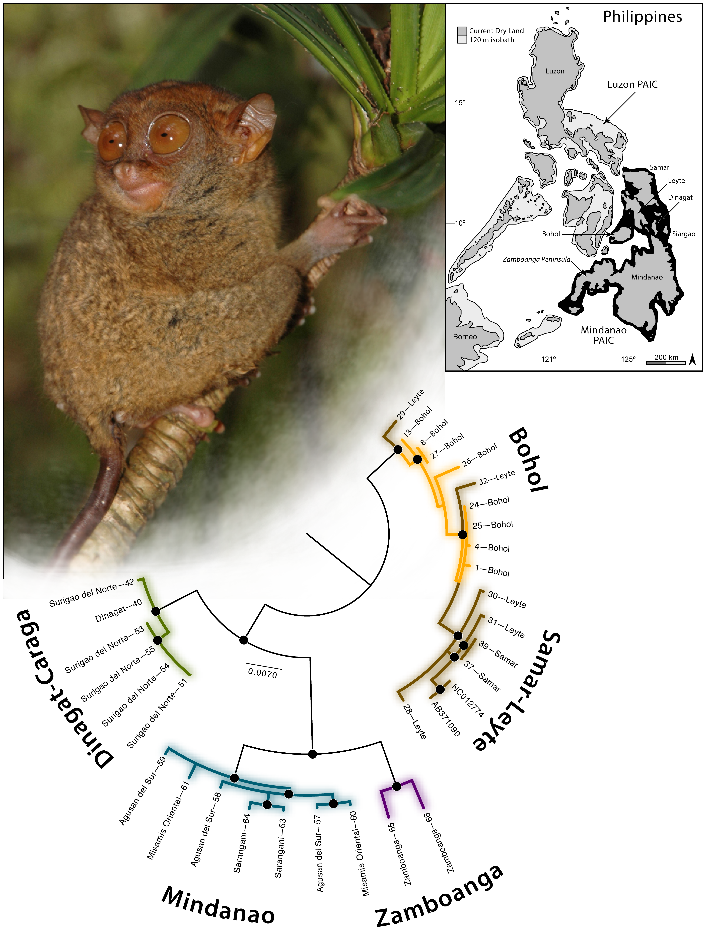
Scale: Species Phylogeography
Criteria:
Representative voucher specimens from all putative subspecies
And/Or
Representatives from throughout species range
Figure 1. Phylogeographic relationships of Tarsius syrichta estimated from a combined, partitioned, RAxML ML analysis of mitochondrial (12S, CytB, ND2) gene fragments.
Brown RM, Weghorst JA, Olson KV, Duya MRM, Barley AJ, et al. (2014) Conservation Genetics of the Philippine Tarsier: Cryptic Genetic Variation Restructures Conservation Priorities for an Island Archipelago Primate. PLOS ONE 9(8): e104340. https://doi.org/10.1371/journal.pone.0104340
http://journals.plos.org/plosone/article?id=10.1371/journal.pone.0104340

Slide 20
Scale: Pathogen Taxonomy Morbilliviruses within Paramyxoviridae
Nambuli et al. Mapping the evolutionary trajectories of morbilliviruses: what where wither. Current Opinion in Virology 2016, 16:95–105

Slide 21
Canine Distemper Virus Emergence in Wildlife
CDV is a Morbillivirus [Measles, phocine distemper, cetacean morbillivirus, peste des petits ruminants, rinderpest (eradicated)] within the family Paramyxoviridae.
RNA virus with unsegmented genome, linear negative sense, single- stranded.
Growing concern as found in increasing numbers of non-canine species in the wild and in managed populations
Global patterns of prevalence
Highly contagious with high morbidity and mortality
Jumps between species with emergent and re-emergent pattern
Genome ~ 15,000 bp encodes 6 structural genes and 2 virulence factor genes

Slide 22
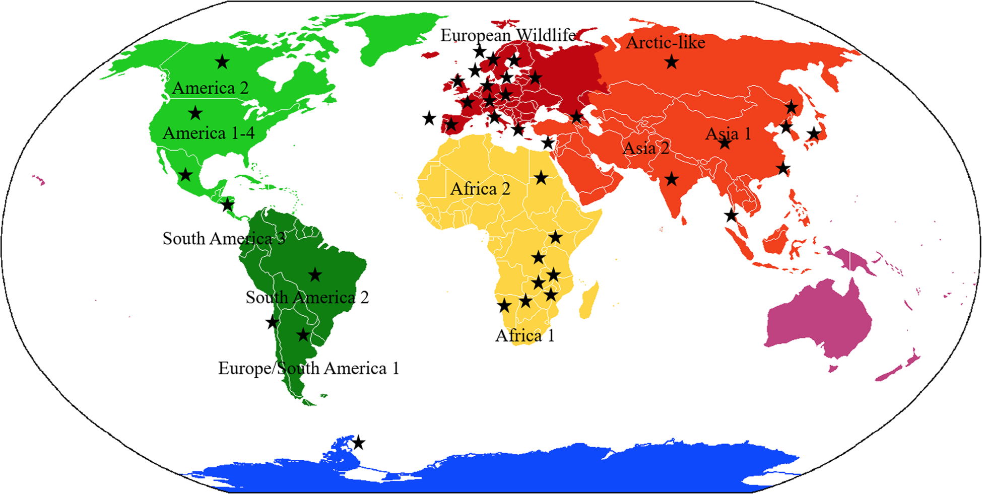
Prevalence of CDV in non-dog species
Martinez-Gutierrez and Ruiz-Saenz BMC Veterinary Research (2016) 12:78

Slide 25
Chlamydia psittaci in Birds and Mammals
Emergent pathogen on a global scale
Obligate intracellular pathogen
Recent expansion from South America into North America
Multiple bird hosts in domestic and wild populations
Respiratory disease in avian species and can be transmitted to humans through inhalation(psitticosis)
Jumps into mammals (ferret, pig, cow, sheep, and human) and has a history of frequently switching hosts
Genome ~ 1.1 Mb with a plasmid size of ~ 8 kb
Core Genome of ~ 911 genes with rapid nucleotide evolution and high rates of recombination.

Slide 26
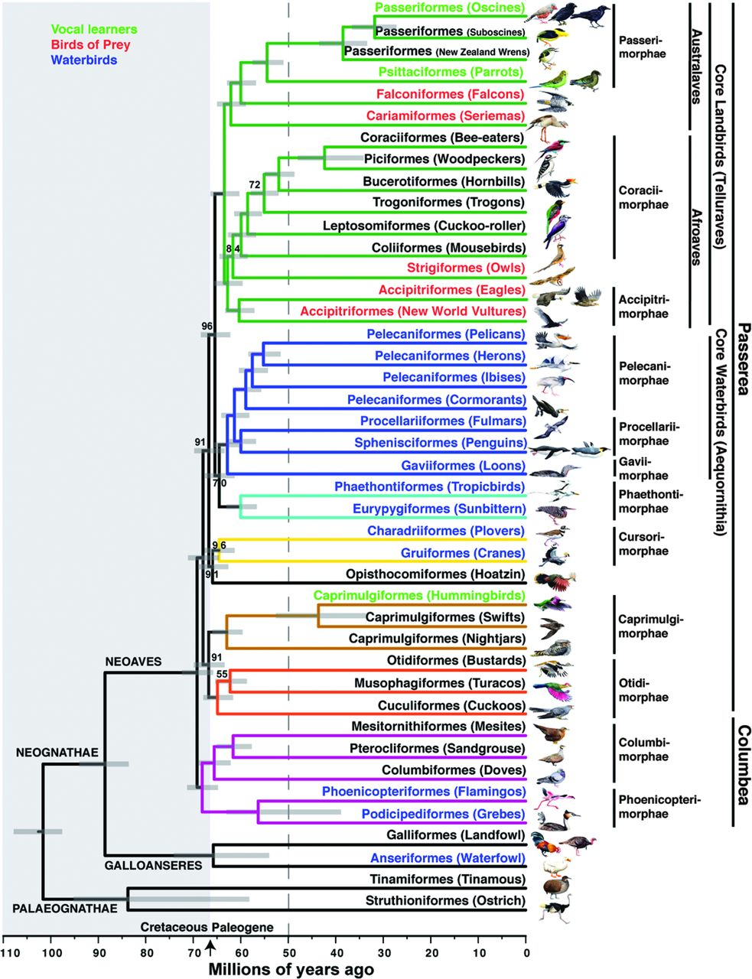

Fig. 1 Genome-scale phylogeny of birds.
Project design 48 species representing all major lineages of birds
Developed orthologs from comparison of human, finch and chicken.
8251 protein coding exons
2516 intron gene set
3679 UCE locus set
Major insights:
1)Genome size and conservation of structure
2) Convergent evolution of vocal learners
3) Evolution of genes related to flight, diet, reproduction, and vision
Erich D. Jarvis et al. Science 2014;346:1320-1331
Published by AAAS

Slide 27
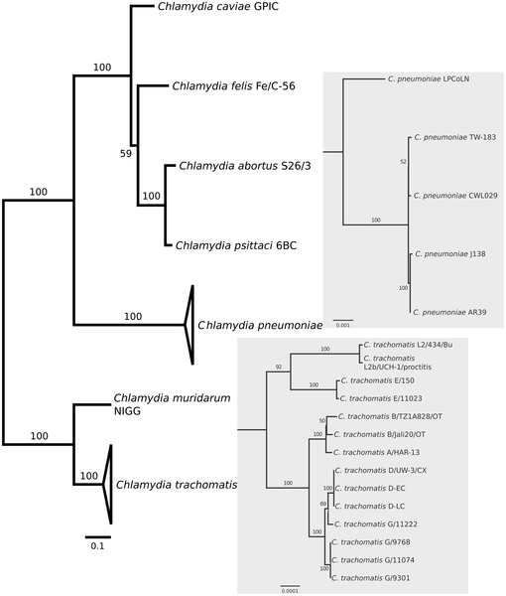

Figure 1. Phylogenomic relationships among sequenced chlamydial genomes.
Voigt A, Schöfl G, Saluz HP (2012) The Chlamydia psittaci Genome: A Comparative Analysis of Intracellular Pathogens. PLOS ONE 7(4): e35097. https://doi.org/10.1371/journal.pone.0035097
http://journals.plos.org/plosone/article?id=10.1371/journal.pone.0035097

Slide 28
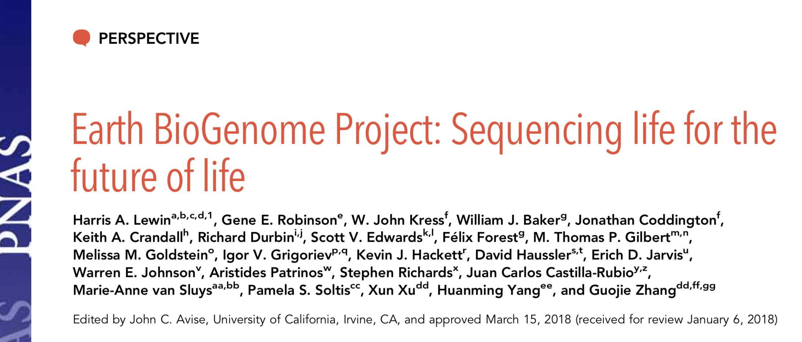
The Future Is Now

Slide 29
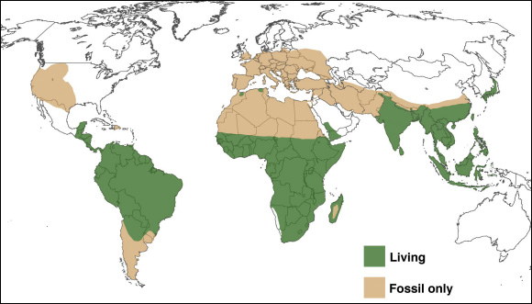
Global Distribution of Primate Species

Slide 30
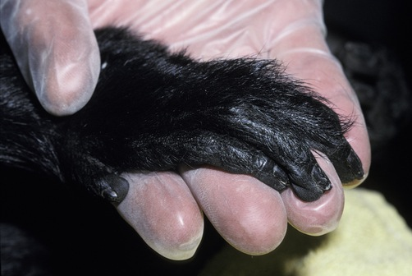
Laying the Foundation: The Complex Order of Primates
Initially imputed from morphological, adaptive, bio-geographical, reproductive and behavioral traits
Species counts range from 261-377, ~ 630 species, subspecies
Genera count range from 67-69 or more?
Genetic studies have been informative but limited:
Too few taxa
Too few gene regions
Super-matrix of all published sequences large proportion of missing data (59-85%) per taxon

Slide 31
Methods
SAMPLING
Representing 90% of diversity present in Primate Order
~90% genera, ~50% species
Boxed species are those either completed or in progress for Whole Genome Sequence
60 Primate Genera, 5 outgroups,
Informative genes of primate evolution
54 genes
Exon, intron, UTR regions
X, Y and Autosome locations
Large-Scale Sequencing
43,943 sites edited to 34,927 sites
8.4 Mb data reduced to 6.7 Mb of aligned sequence data
PHYLOGENETIC RECONSTRUCTION
Maximum Likelihood (Garli ver 0.96)
Maximum Parsimony (PAUP ver 4d106dev_icc)
DATING NODES (BEAST)
Calibrated by fossil record
A Galigidae-Lorisidae split 38-42 MYA
B Simiiformes 36-50 MYA
C Catarrhini 20-38 MYA
D Platyrrhini 20-27 MYA
E Papionini 6-8 MYA
F Theropithecus 3.5-4.5 MYA
G Hominidae 13-18 MYA
H Homo-Pan split 6-7 MYA

Slide 32
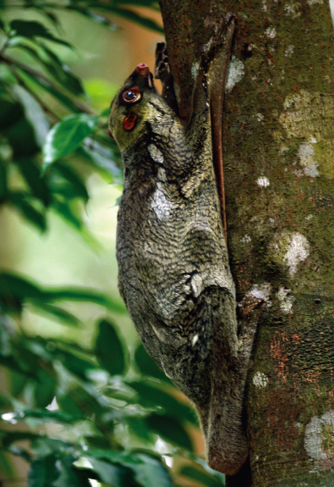
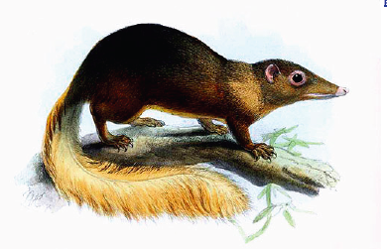
Molecular Phylogeny of 186 primates, 5 outgroup taxa, rooted by Lagomorpha
Highly Resolved
Bootstrap values 90-100% at 166/189 nodes
Only 3 of 189 nodes (28, 38, 158) polytomy
Systematic Hierarchy
2 Suborders
5 Infraorders
2 Parvorders
2 Superfamilies
14 Families
14 Subfamilies?
4 Tribes?
Resolution of Early Primate Divergence
Origin of living primates 87 MYA
Closest Mammalian Order:
Dermoptera (flying lemurs)
Scandentia (tree shrews)
87 MYA

Slide 33
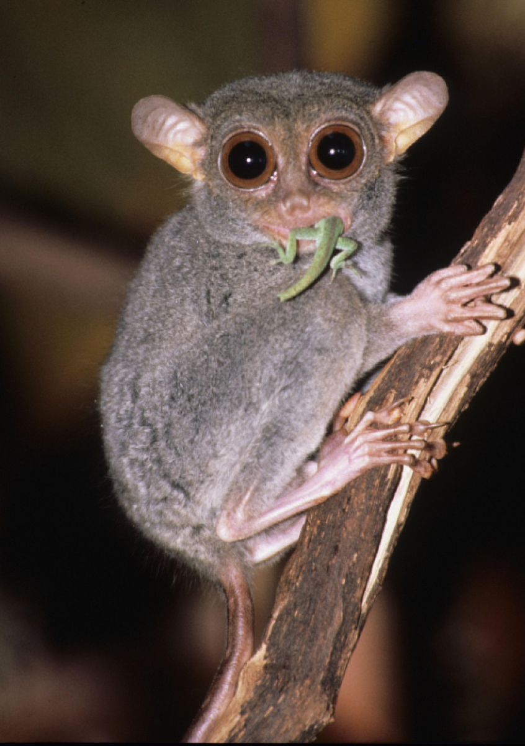
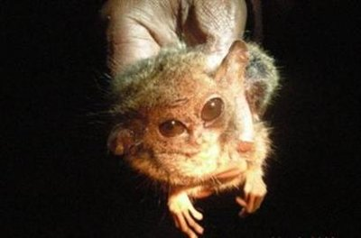
Resolution of Deep Nodes: Ancient Origins and Relic Lineages
Ancient Origin of the Tarsier
Tarsiiformes + Simiiformes = Haplorrhini
Smallest primate –pygmy tarsier
81 MYA
58 MYA
68 MYA
40 MYA

Slide 34
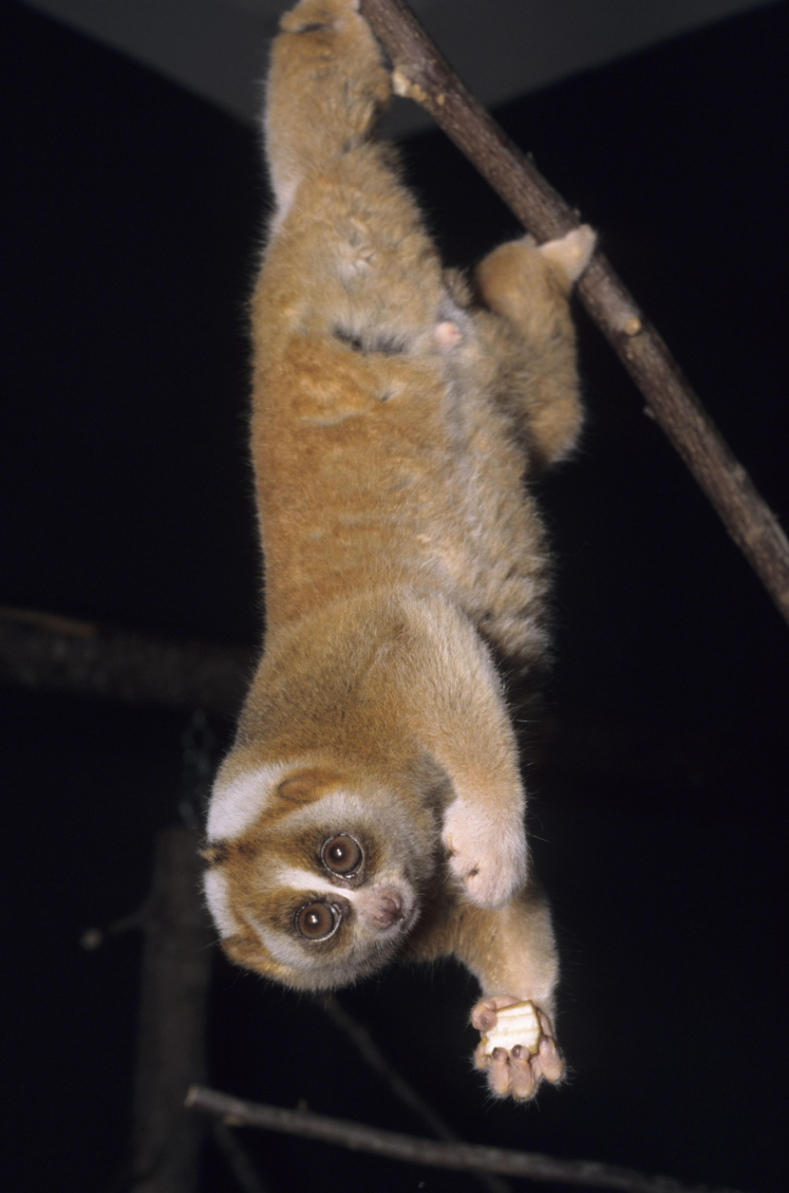
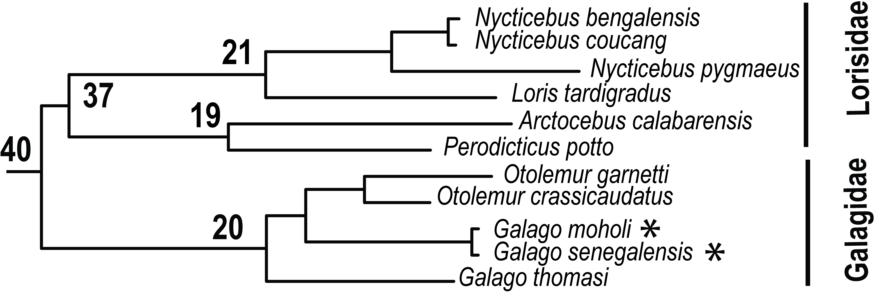
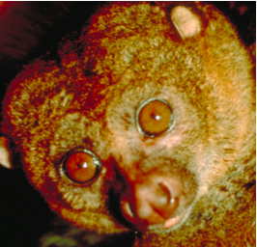
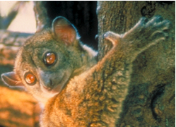
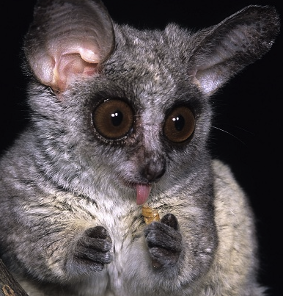
Strepsirrhini: Lorisiformes
Potto, Loris, Bushbaby
Lorisidae
Most divergent of all primates families
(4-5 times that of Hominidae)
Low numbers of species (1-3 per genus)
Galagidae
Ancient ancestry and recent speciation
in Galago genus (~14 species)

Slide 35
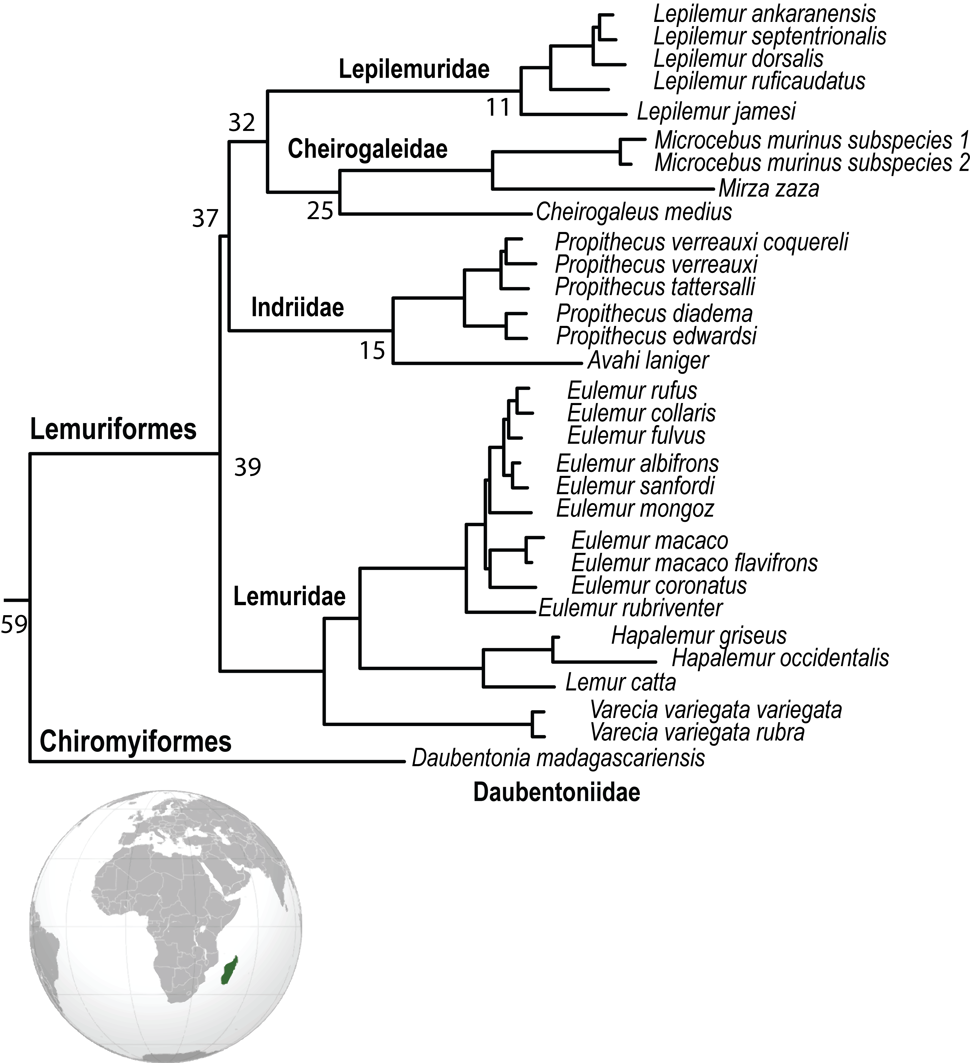
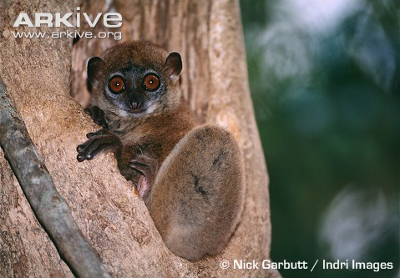
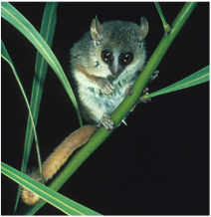
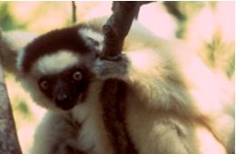
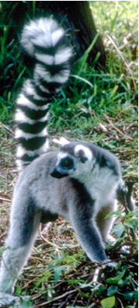
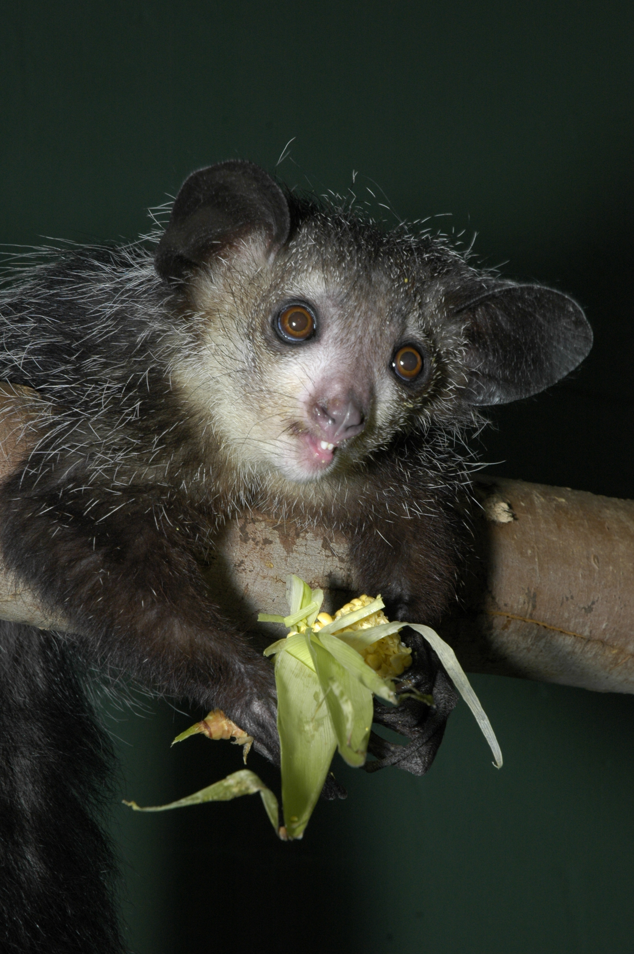
Strepsirrhini: Malagazy Lemurs
Malagazy Lemurs
Two Ancient Infraorders
Common ancestor colonized Madagascar
Extensive diversification
~97 species of lemur
Numerous adaptations

Slide 36
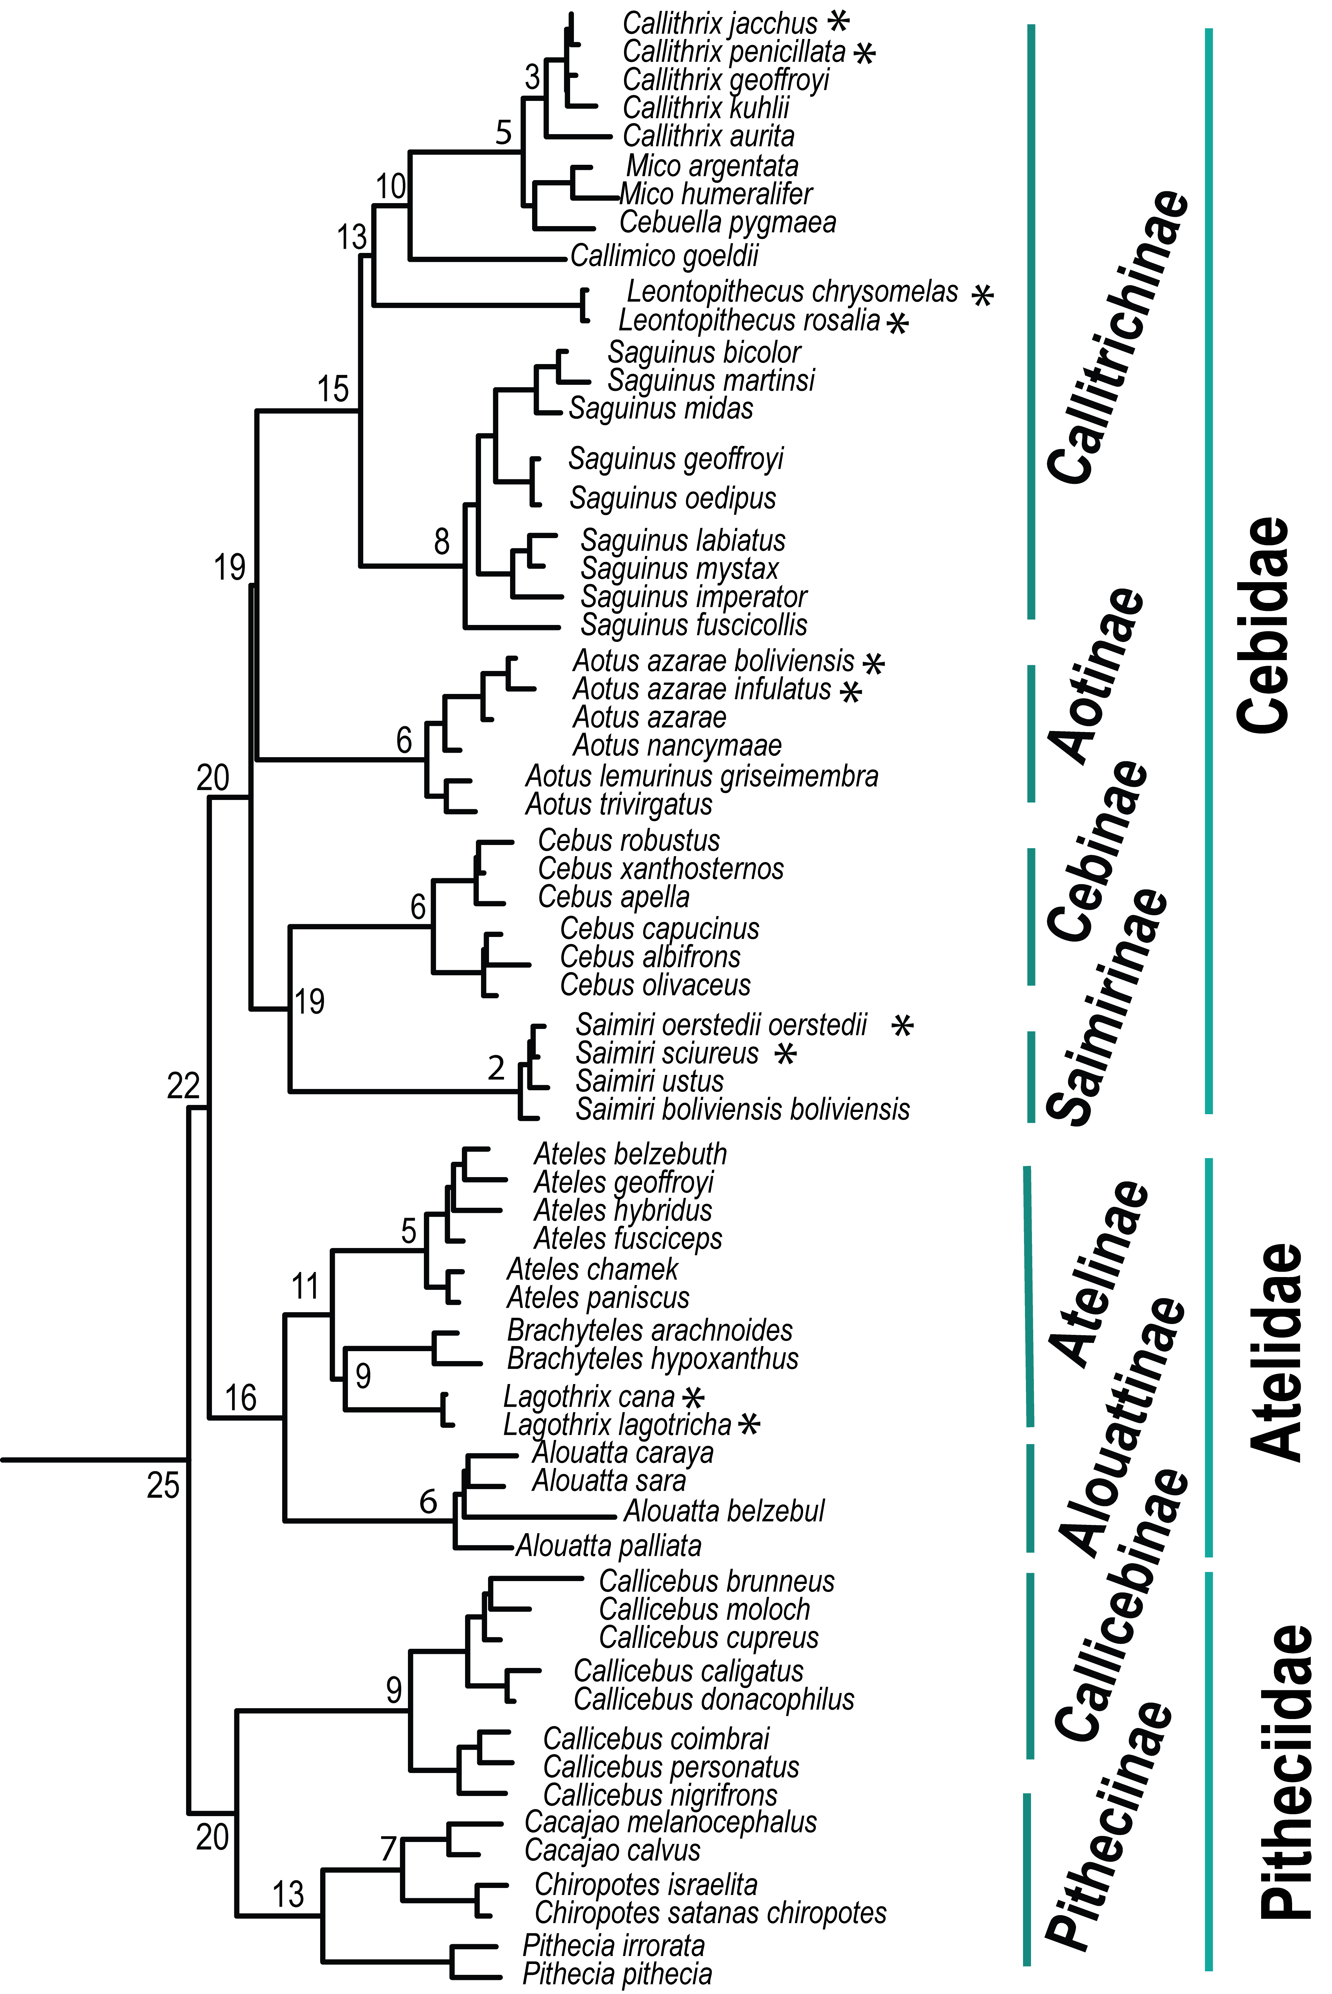
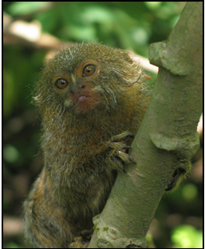
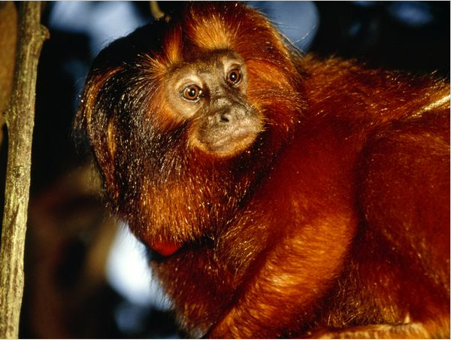
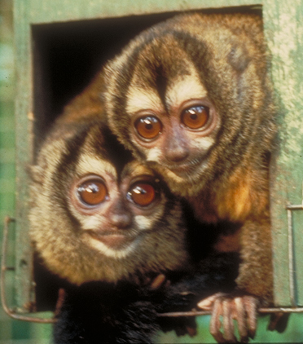
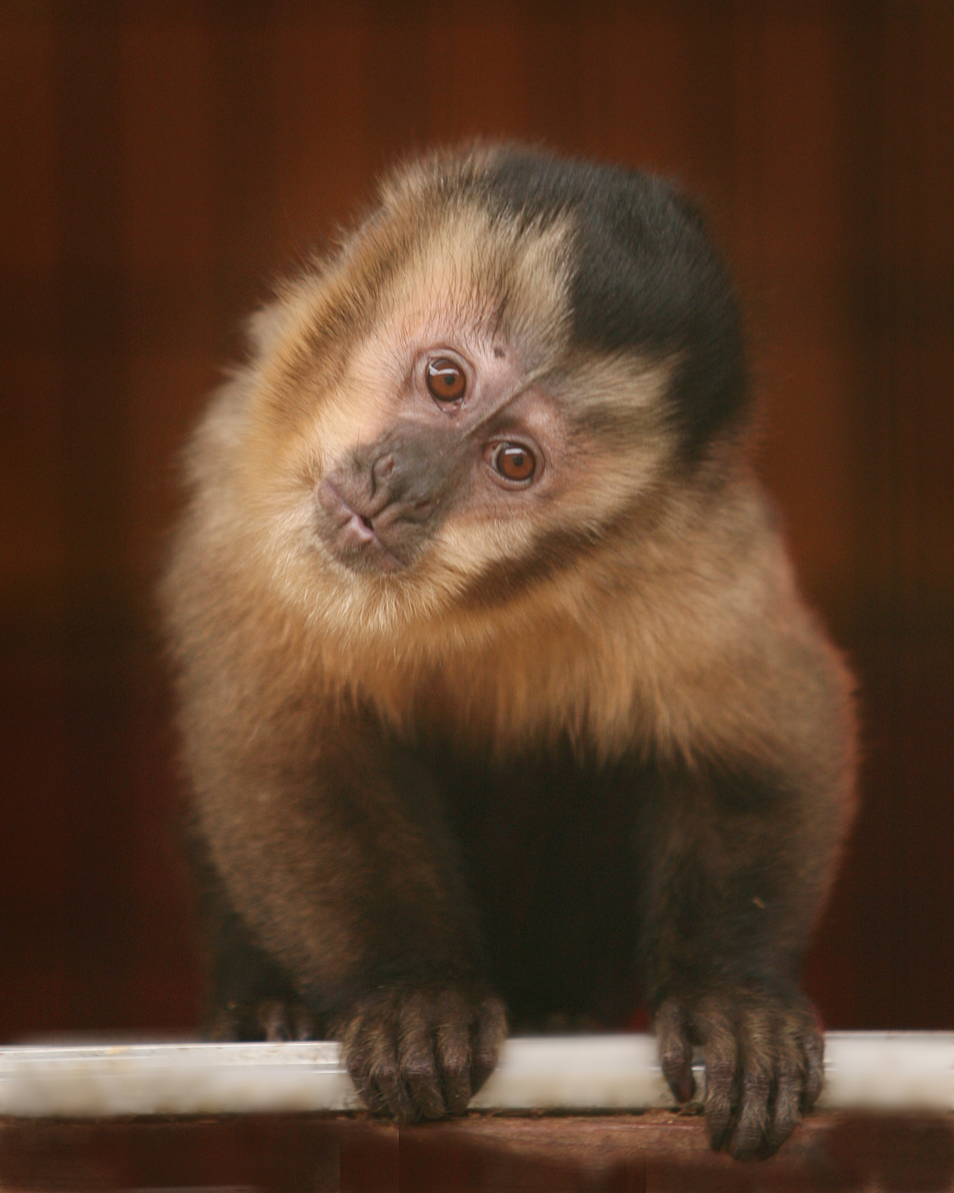
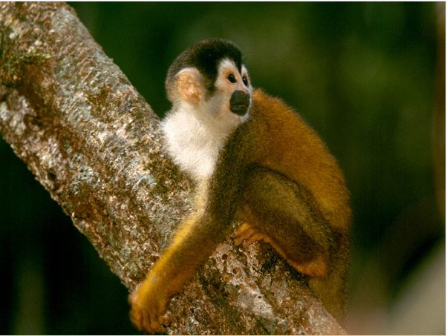
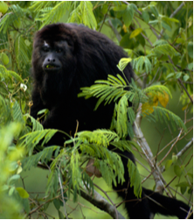
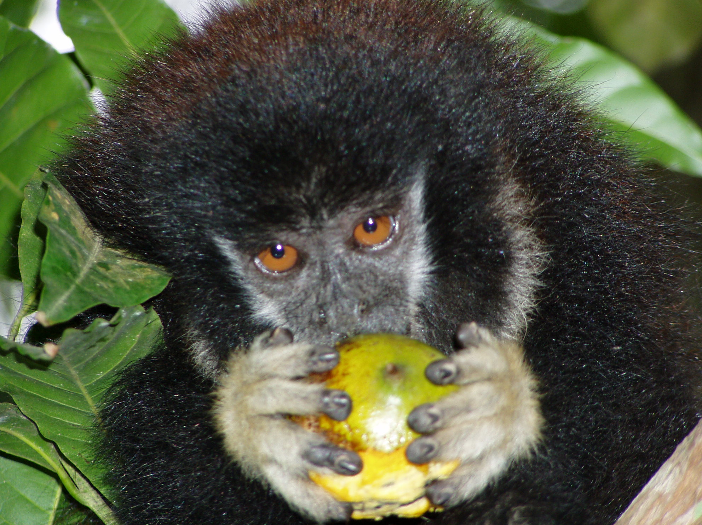
Platyrrhini (New World Primates)
Resolution of Branching Order of Families
25 MYA
Placement of Aotinae (nocturnal species)
Phyletic dwarfism within Cebidae
Adaptive “speed up” at specific branches

Slide 37
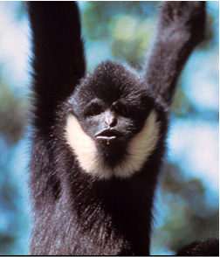
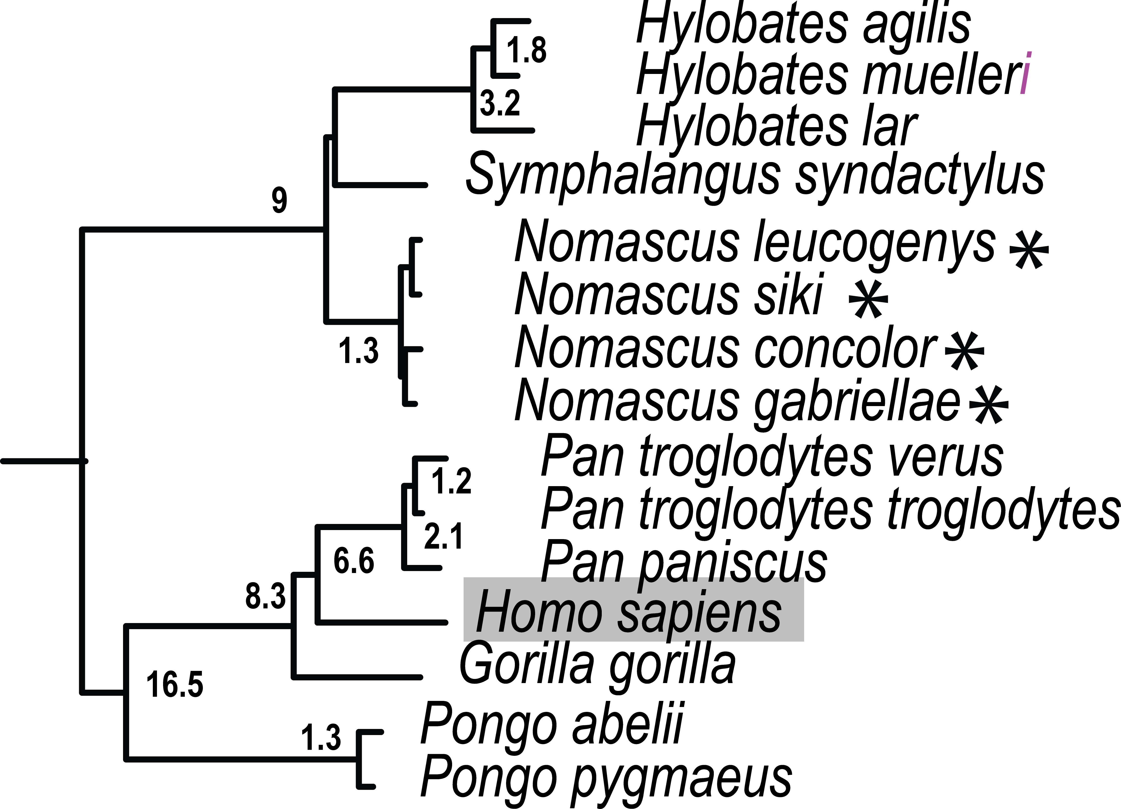
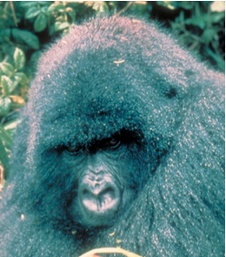
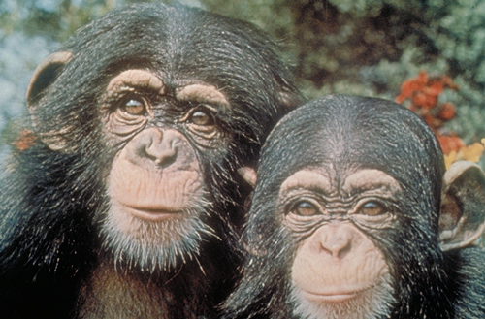
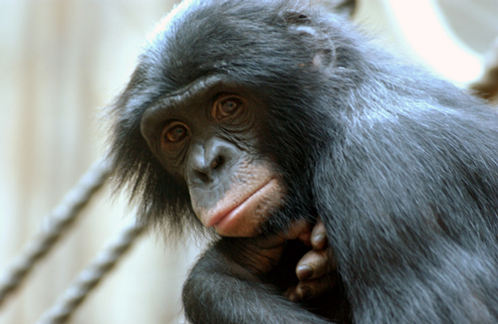
Hominoidea: Great Apes, Human, Gibbons
Hylobatidae:
Siamang, gibbon, hoolock
Exceptional rates of chromosome re-arrangement.
Each of 4 genera defined by different numbers of chromosomes.
Diverged rapidly from each other
Hominidae:
The largest primate Gorilla
Who is closest relative, Pan troglodytes or Pan paniscus?
20
Notes:
.

Slide 38
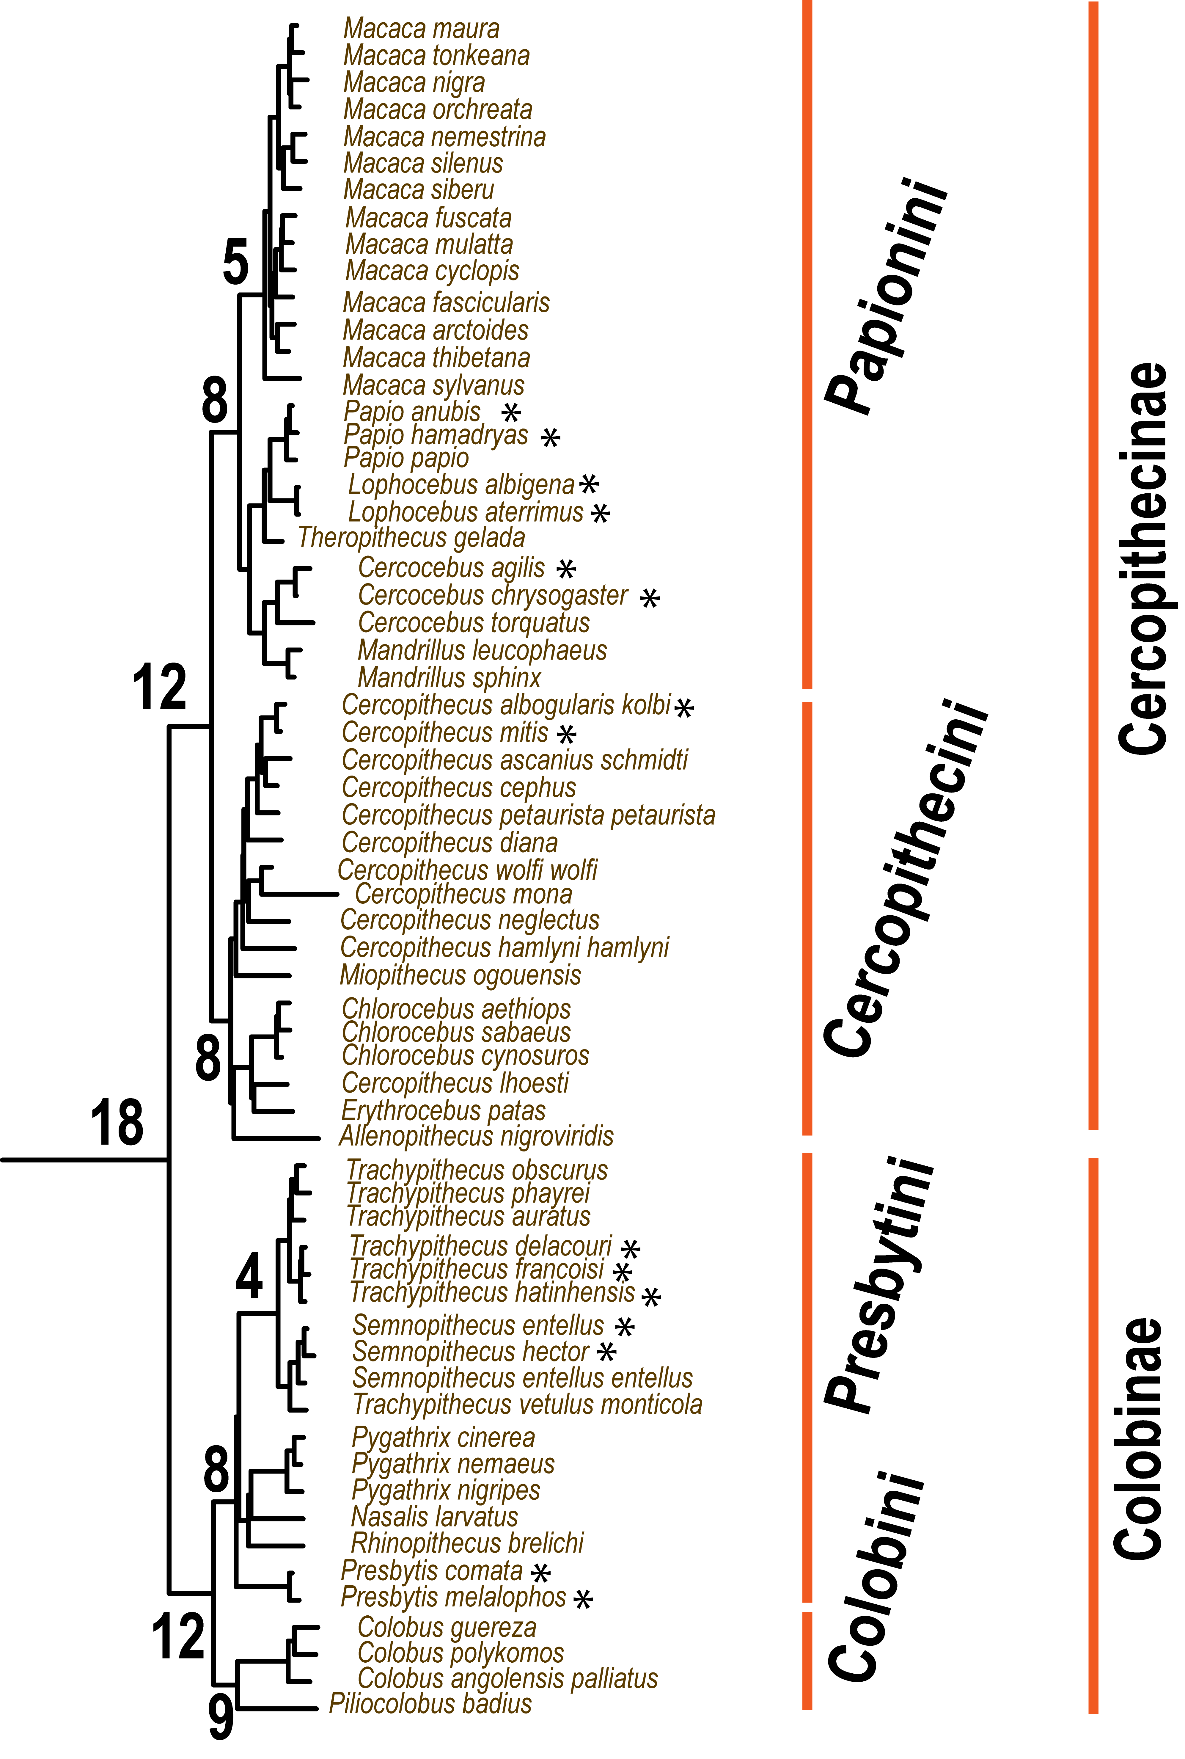




Cercopithecoidea: Old World Monkeys
Two Subfamilies
Cercopithecinae
macaques, baboons
Higher proportion of recent species (asterisk) < 1 MYA
Ongoing hybridization and introgression sympatric species
Colobinae:
Digestive adaptation to arboreal leaf eating existence
Asian and African tribes
Taxonomic revision of Trachypithecus, Presbytis, Semnopithecus

Slide 39

Scopus Classification of Citations of Primate Phylogeny

